Slide 1
Transformers and Attention:
ID2223 Scalable Machine Learning and Deep Learning
Karl Fredrik Erliksson
Industrial PhD Candidate, KTH and Peltarion
November 25, 2020
Notes:
Karl, PhD candidate under Amir’s supervision. My research, explainable AI, specifically focusing on NLP. In today’s lecture: Recent advances in NLP, so called Transformer architecture with the attention mech.
Really exciting topic with a lot of impressive progress lately. Feel free to interrupt and ask question, or write in the chat.

Slide 2
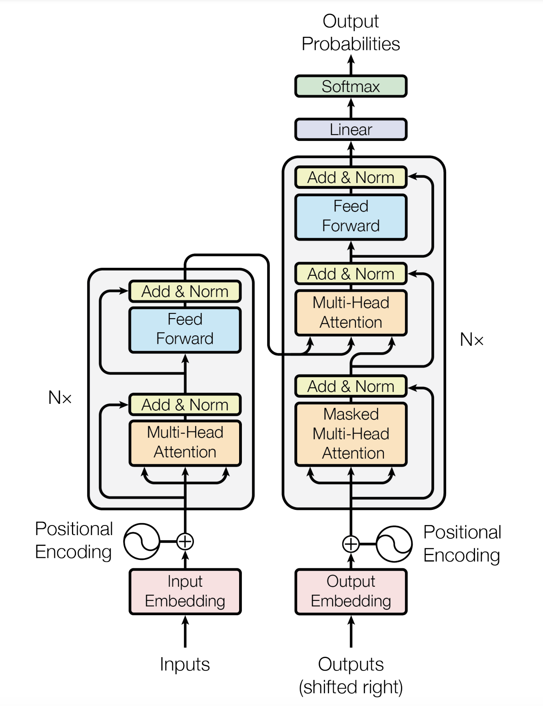
Roadmap
01
02
03
04
05
Contextualized Embeddings
From RNNs to Transformers
Transformers Step-by-Step
BERT
Distillation and Practical Example
Notes:
Contextualized embeddings and background to NLP.
Motivation for Transformers
…
In the very end the plan is to discuss some practical aspects and code snippets. Thanks to transfer learning and some recent good software packages, very easy to use these models yourself. Encourage you to try it out!

Slide 3
Acknowledgements
Material based on:
Christoffer Manning’s NLP Lectures at Stanford
The Illustrated Transformer by Jay Alammar
Slides from Jacob Devlin
Self-attention Video from Peltarion
Notes:
Before we start…
This list also serves as a good reference for anyone who is interested in the topic and want to learn more.

Slide 4
01
Contextualized Embeddings

Slide 5
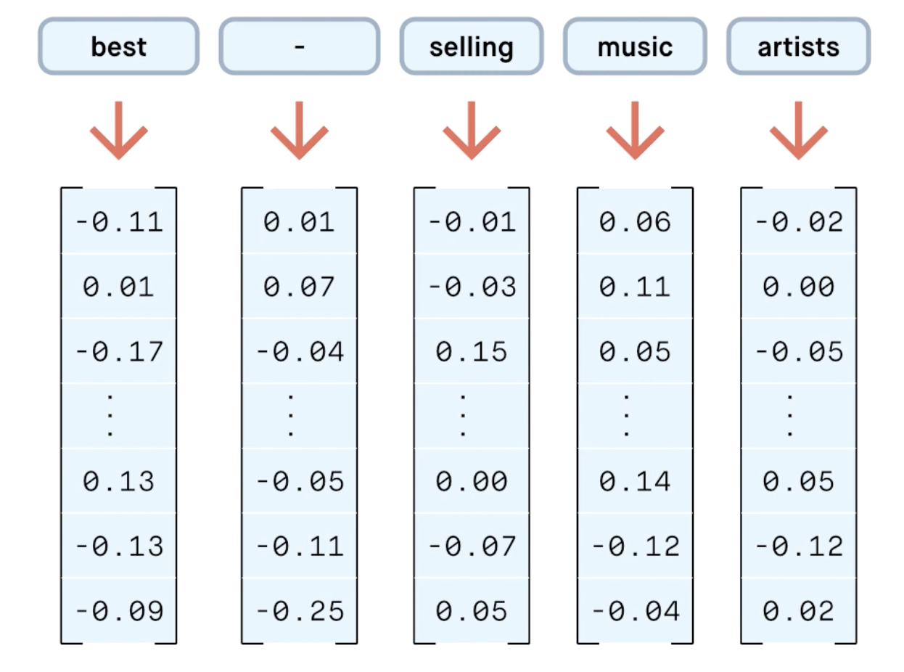
Background to Natural Language Processing (NLP)
Word embeddings are the basis of NLP
Popular embeddings like GloVe and Word2Vec are pre-trained on large text corpuses based on co-occurrence statistics
“A word is characterized by the company it keeps” [Firth, 1957]
[Peltarion, 2020]
Notes:
Last lecture - RNN and one-hot encodings.
In practice, we use word embeddings. Represent a word or subword/token by a dense vector.
Secret sauce of NLP. Great success in the last decade. When NNs became competitive for NLP.

Slide 6
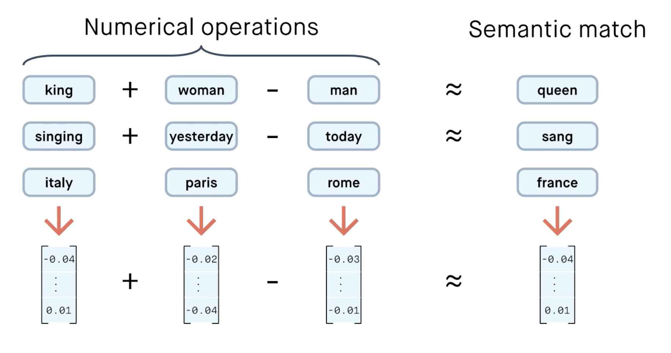
Word Embeddings
[Peltarion, 2020]
Notes:
Cool thing about word embeddings: Can perform numerical operation on top of the embeddings!
The embeddings encode semantic meaning. Very useful for our NN models, a great reason for the NLP success in the beginning of the decade.
Neat! Question: Problems of word embeddings? (different meanings of the same word)

Slide 7
Word Embeddings
Problem: Word embeddings are context-free
[Peltarion, 2020]

Slide 8
Word Embeddings
Problem: Word embeddings are context-free
[Peltarion, 2020]
Notes:
Sense of a word in the context that is used.
Not just semantics

Slide 9
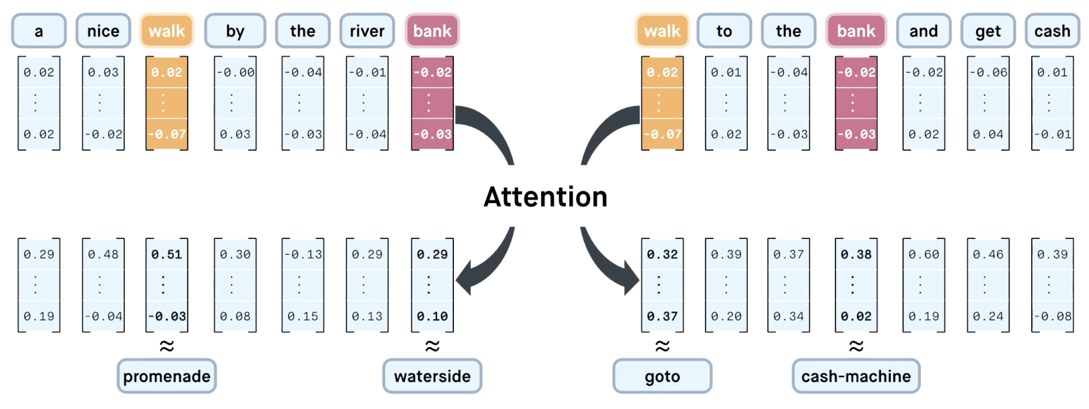
Word Embeddings
Problem: Word embeddings are context-free Solution: Create contextualized representation
[Peltarion, 2020]
Notes:
“Instead of using a fixed embedding for each word, ELMo looks at the entire sentence before assigning each word in it an embedding.”

Slide 10
02
From RNNs to Transformers

Slide 11
Problems with RNNs - Motivation for Transformers
Sequential computations prevents parallelization
Despite GRUs and LSTMs, RNNs still need attention mechanisms to deal with long range dependencies
Attention gives us access to any state… Maybe we don’t need the costly recursion? 🤔
Then NLP can have deep models, solves our computer vision envy!
Notes:
Question: You talked about RNNs in yesterday’s class. Can you think f any limitations?
RNNs and LSTMs: Actually can be thought of as creating contextualized representations, then attention to align representations etc.
Why need attention: Think of the encoder-decoder setup and in the case where we have a long sentence we want to translate.
Need to pack all the information we need into the output vector for the encoder.
Instead let the model have access to all encoder states and softly attend to the part that is important for the current decoder output step.
CNNs: Easier to parallilize, but need to be very deep for long dependencies.
Faster to build bigger models.

Slide 12
Attention is all you need! [Vaswani, 2017]
Sequence-to-sequence model for Machine Translation
Encoder-decoder architecture
Multi-headed self-attention
Models context and no locality bias
[Vaswani et al., 2017]
Notes:
Attention is all you need, get rid of the recurrent stuff.
Task: NMT

Slide 13
03
Transformers Step-by-Step

Slide 14
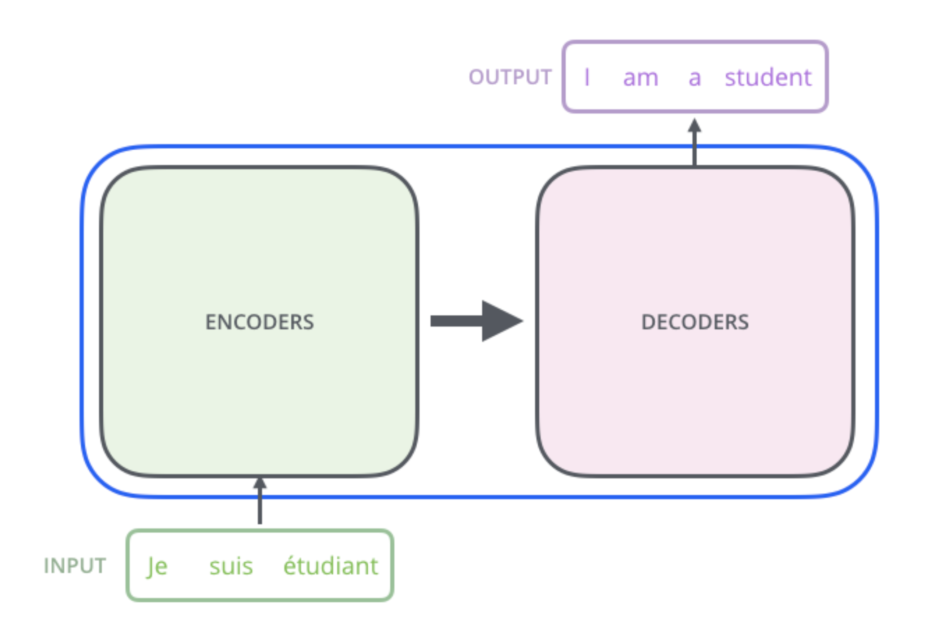
Understanding the Transformer: Step-by-Step
[Alammar, 2018]
Notes:
Zoom out

Slide 15
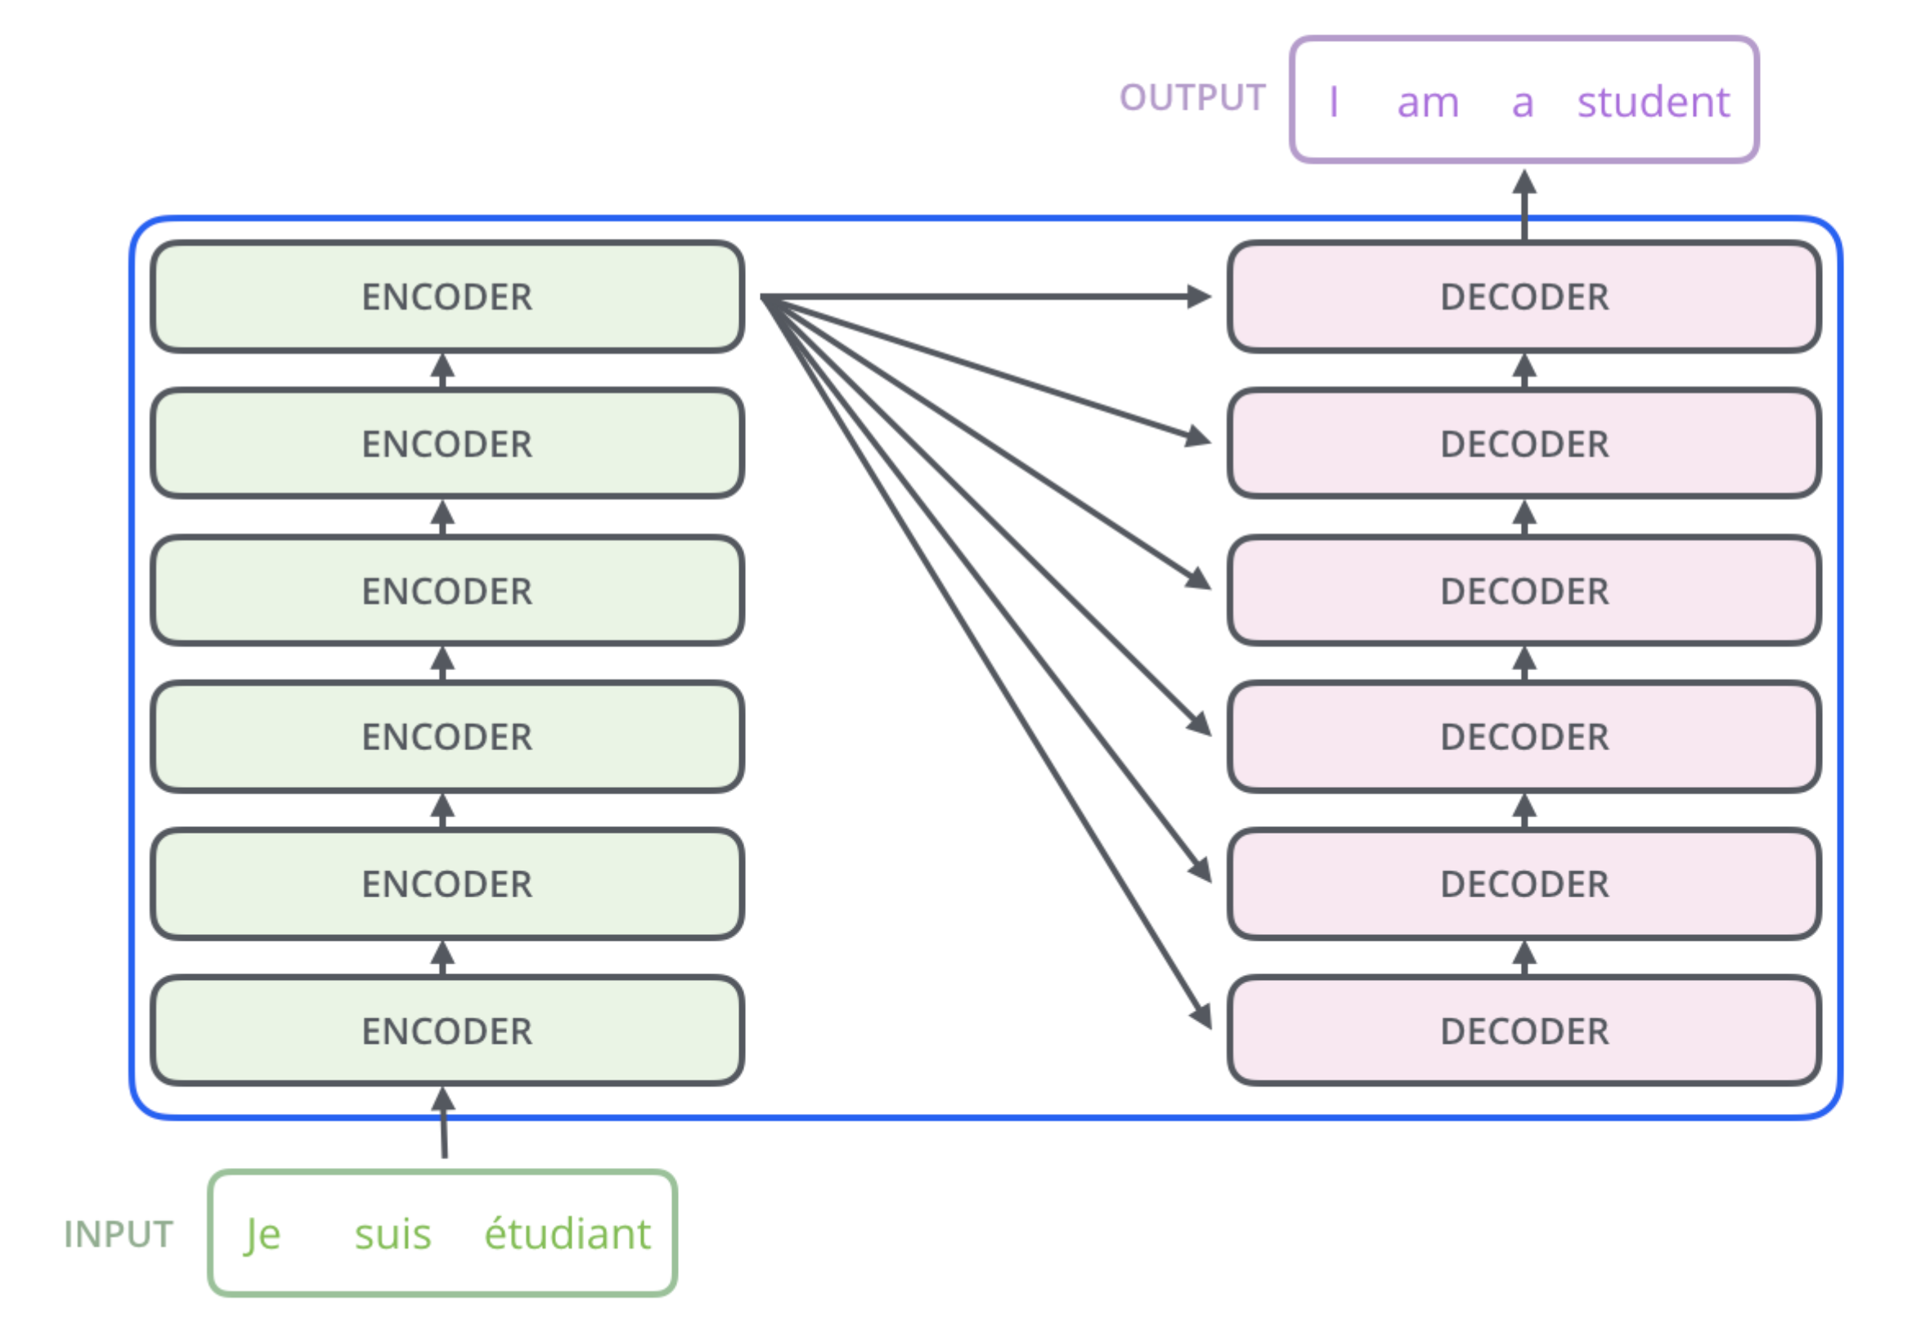
Understanding the Transformer: Step-by-Step
No recursion, instead stacking encoder and decoder blocks
Originally: 6 layers
BERT base: 12 layers
BERT large: 24 layers
GPT2-XL: 48 layers
GPT3: 96 layers
[Alammar, 2018]
Notes:
GPT3 175B parameters (4.6 M USD on cheapest GPU to train, 355 GPU years)

Slide 16
The Encoder Block
[Alammar, 2018]

Slide 17
The Encoder and Decoder Blocks
[Alammar, 2018]

Slide 18
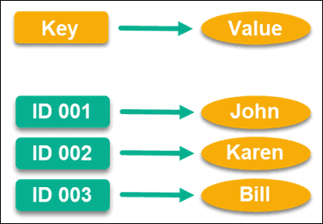
Attention Preliminaries
Mimics the retrieval of a value v_{i} for a query q based on a key k_{i} in a database, but in a probabilistic fashion
Database
Query q
Value v_{i}
Notes:
Use a query to match with a key and retrieve the corresponding value
Probabilistic fashion: Fuzzy match against the keys and create a weighted sum of the values
Preliminaries to get used to the terminology and what it means.

Slide 19
Dot-Product Attention
Queries, keys and values are vectors
Output is a weighted sum of the values
Weights are are computed as the scaled dot-product (similarity) between the query and the keys
Output is a row-vector
Can stack multiple queries into a matrix Q
Output is again a matrix
Self-attention: Let the word embeddings be the queries, keys and values, i.e. let the words select each other
Notes:
Simplest kind of attention - dot-product. Can be implemented efficiently as a matrix product.
Other common types of attention are additive.
Similarity against every row (element) in K.
Dk (scaling factor) prevents the dod-product from becoming too large and thus pushing the softmax far away from zero where the gradient is vanishing.
Softmax over the embedding dimension

Slide 20
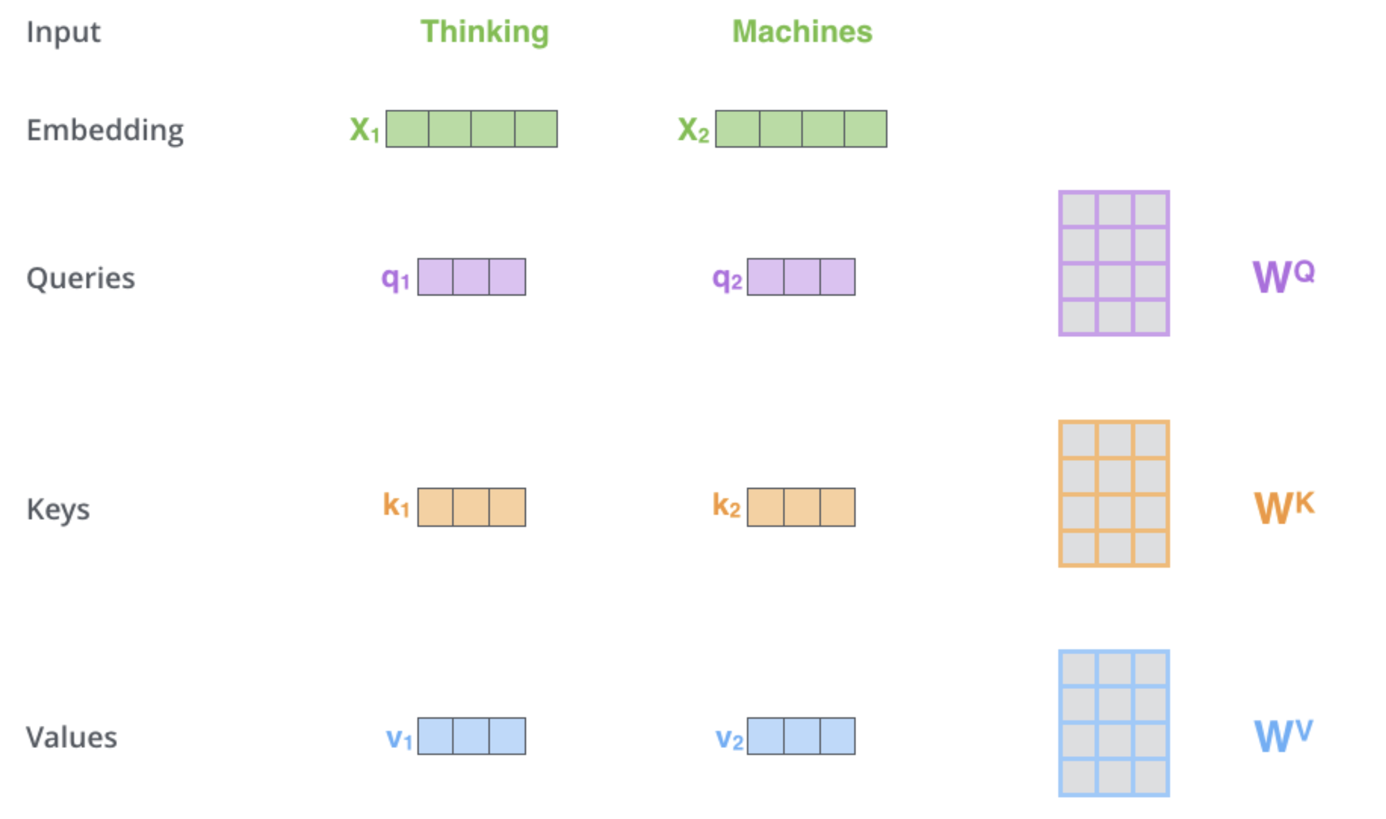
Self-Attention Mechanism
[Alammar, 2018]
Notes:
Learnable projections of the word embeddings. “Looking in different directions in embedding space”

Slide 21
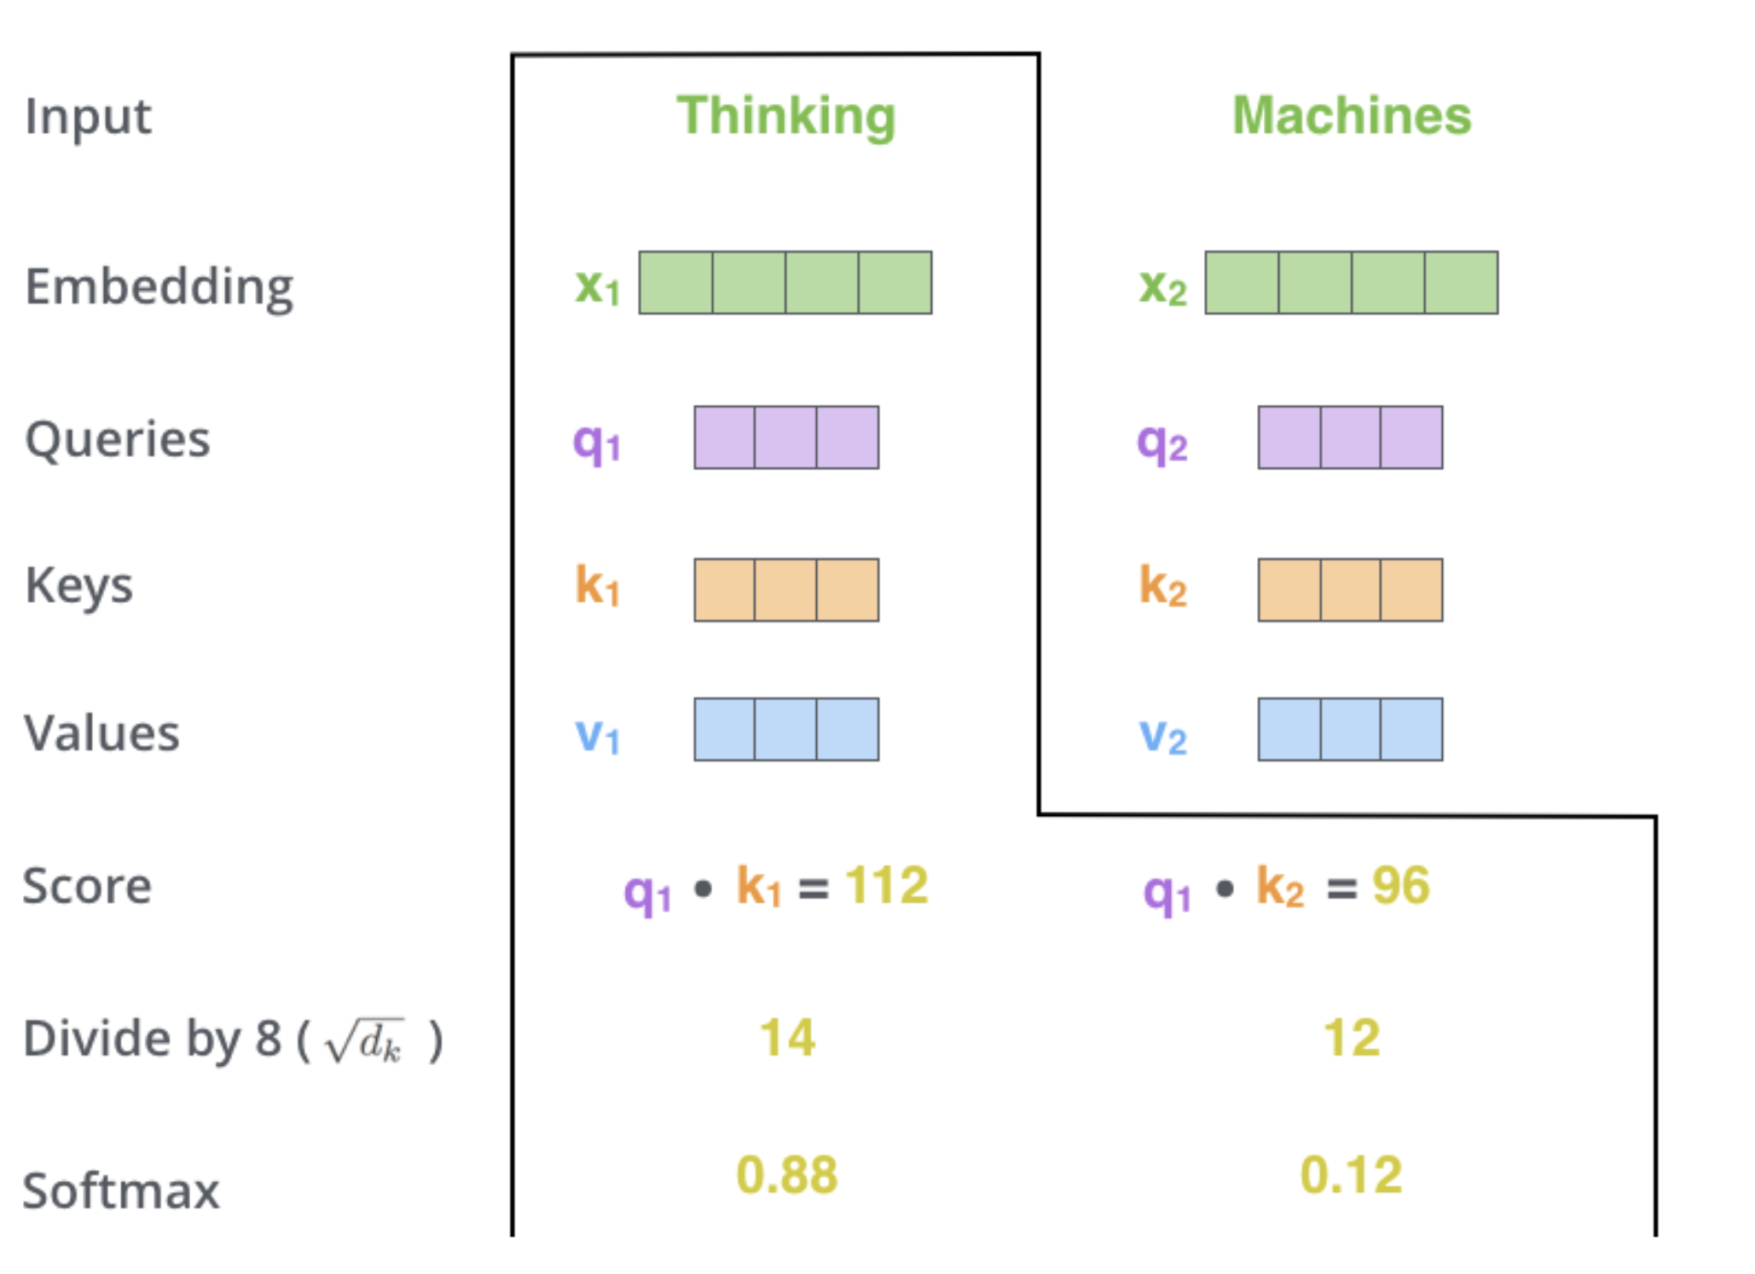
Self-Attention Mechanism
[Alammar, 2018]
Notes:
Let’s look at the first word as an example

Slide 22
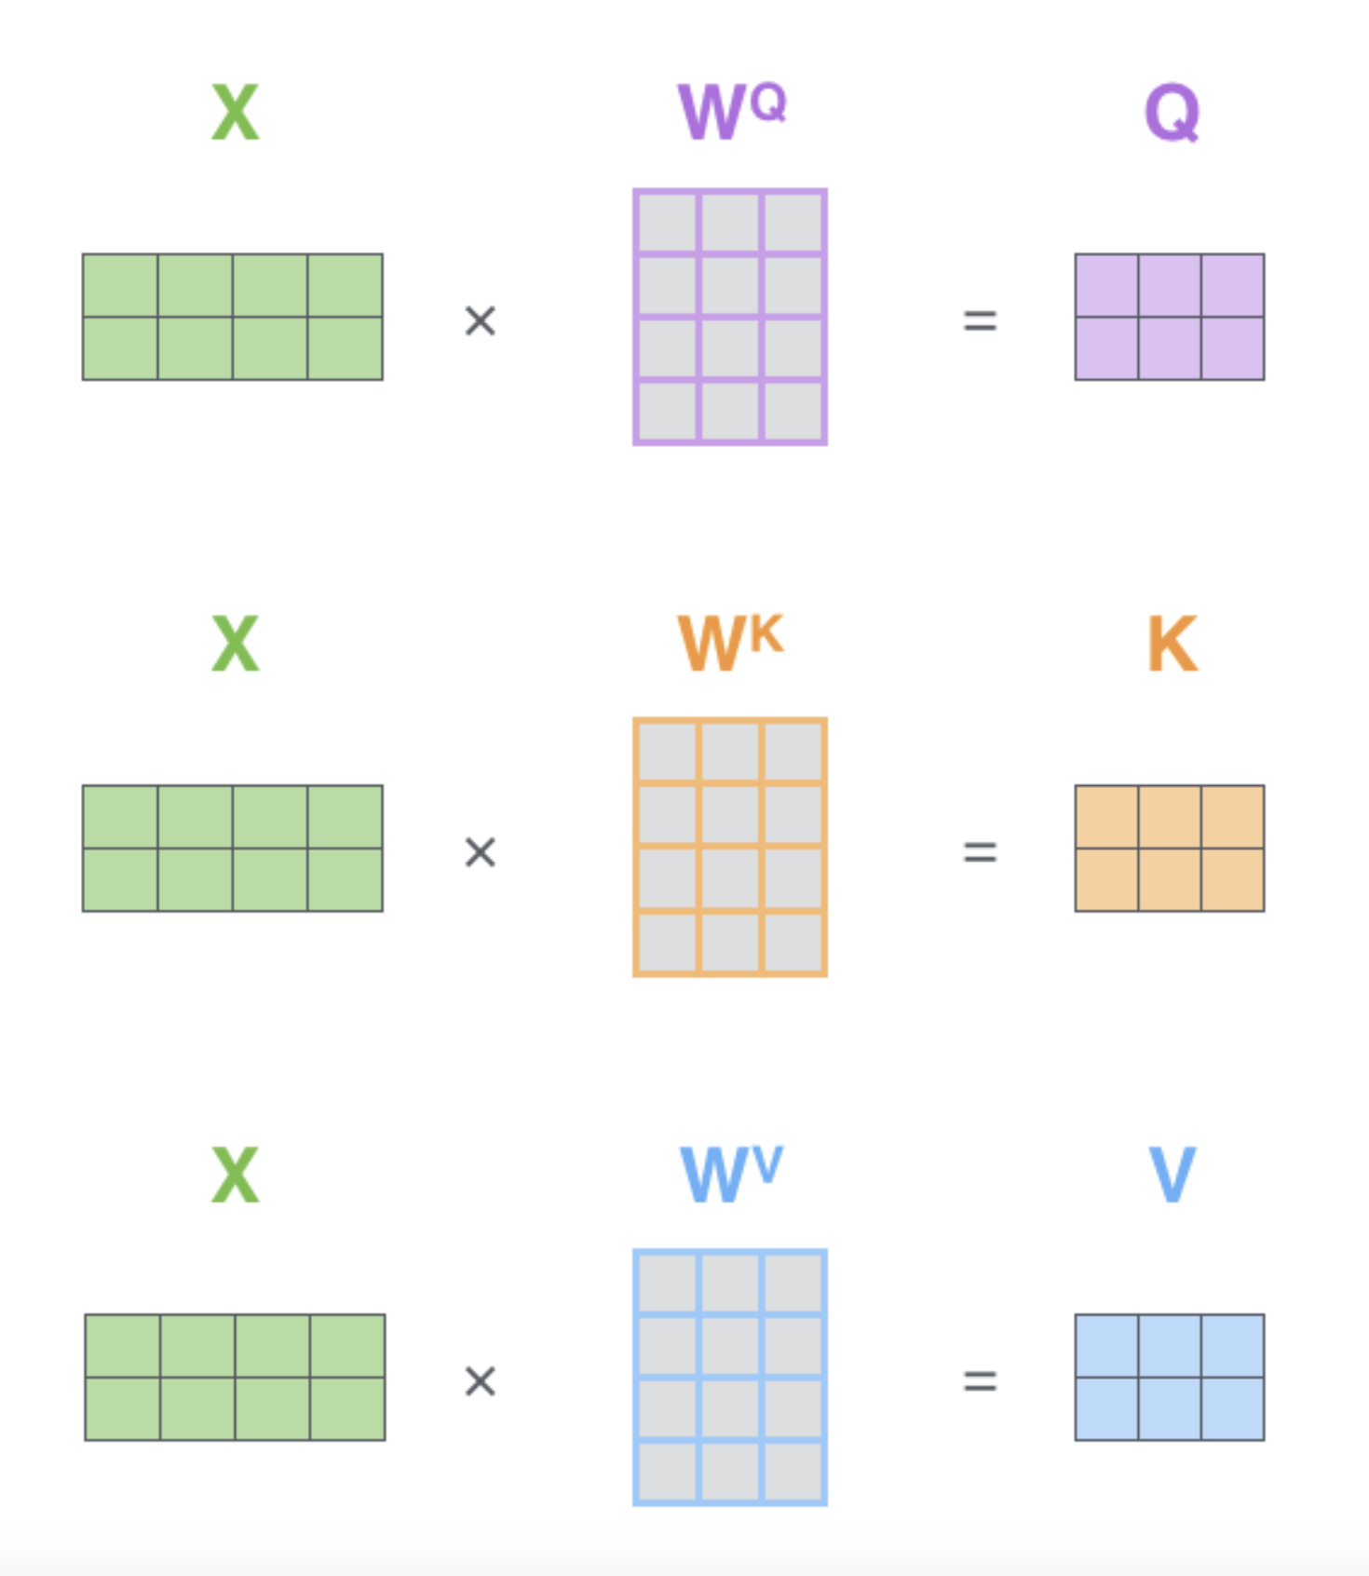
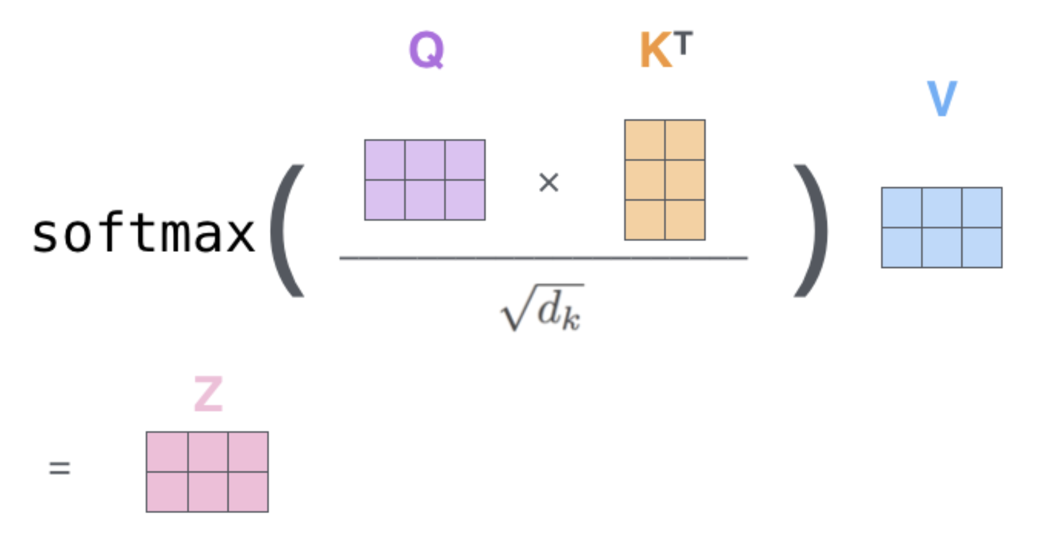
Self-Attention Mechanism in Matrix Notation
[Alammar, 2018]
Notes:
Now in matrix notation!
Stack word embeddings as rows. Matrix multiplications to get projects representations for query, keys and values. Dot-product not becomes Q*K^T.
Z matrix it the new embedding matrix (word embeddings still in the rows) after the attention mech.

Slide 23
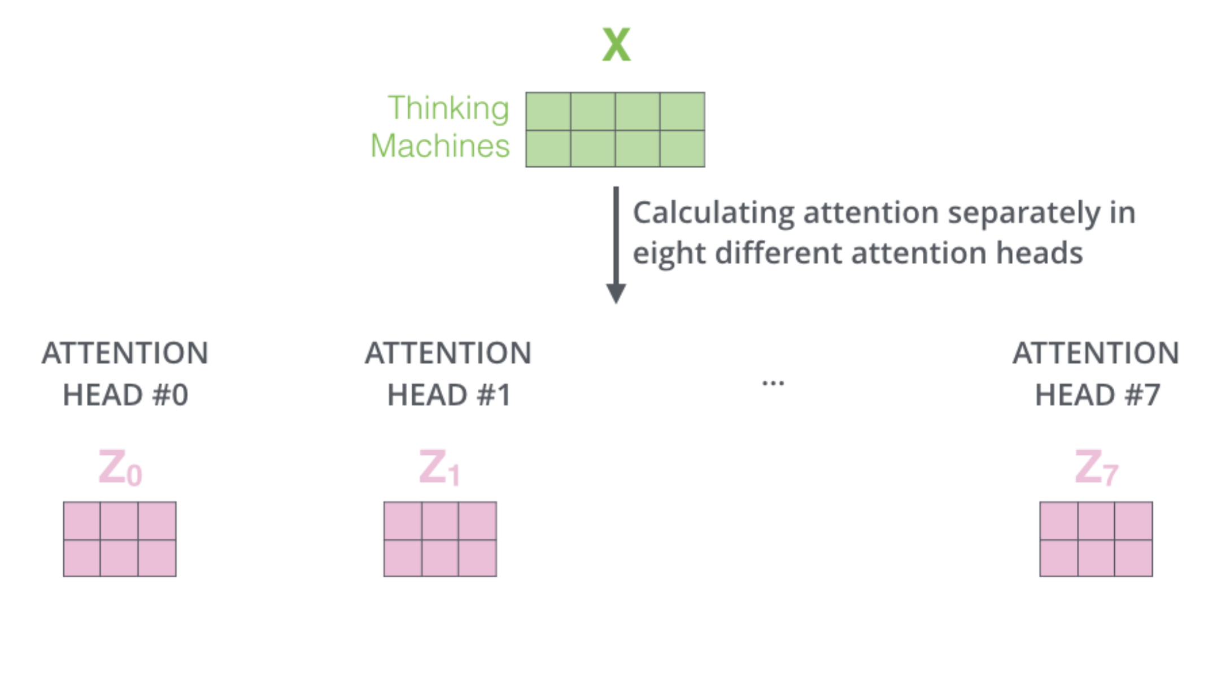
Multi-Headed Self-Attention
[Alammar, 2018]
Notes:
More general formulation. Perhaps we need to attend att different passages in the same layer, to improve the expressitivity.
The value representation is 768/8=96

Slide 24
Multi-Headed Self-Attention
[Alammar, 2018]

Slide 25
Self-Attention: Putting It All Together
[Alammar, 2018]

Slide 26
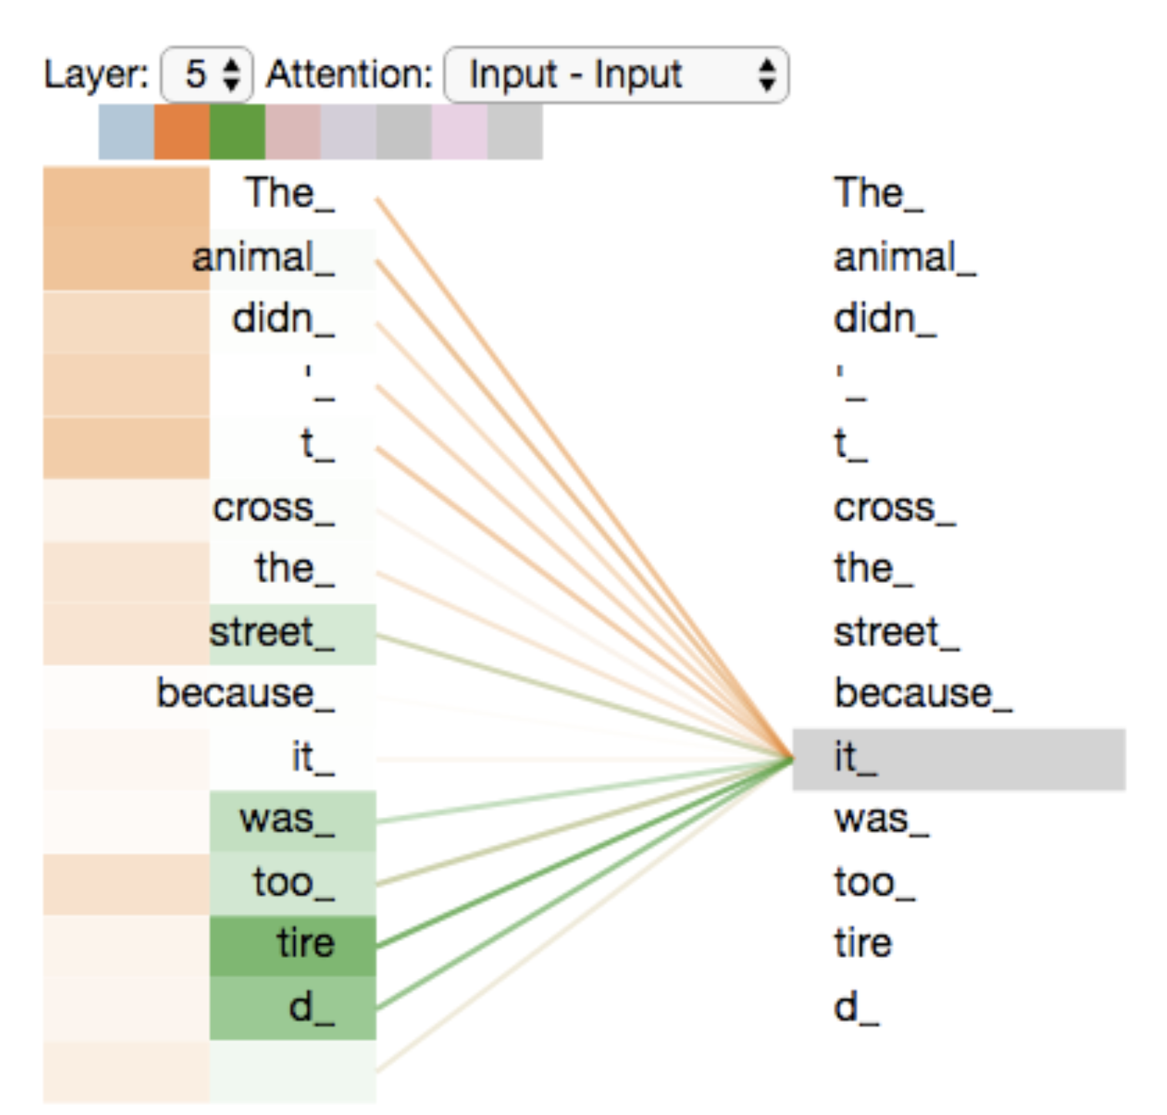
Attention visualized
Notes:
Two heads visualized
Query is the word it
One head is focusing on “the animal”, i.e. what it refers to
The other head on “tired”, the adjective describing “it”.
Some recent reserach on interpreting the attention heads. Pick up different lingustic phenomnea (noun modifiers, prepositions, direct objects etc)

Slide 27
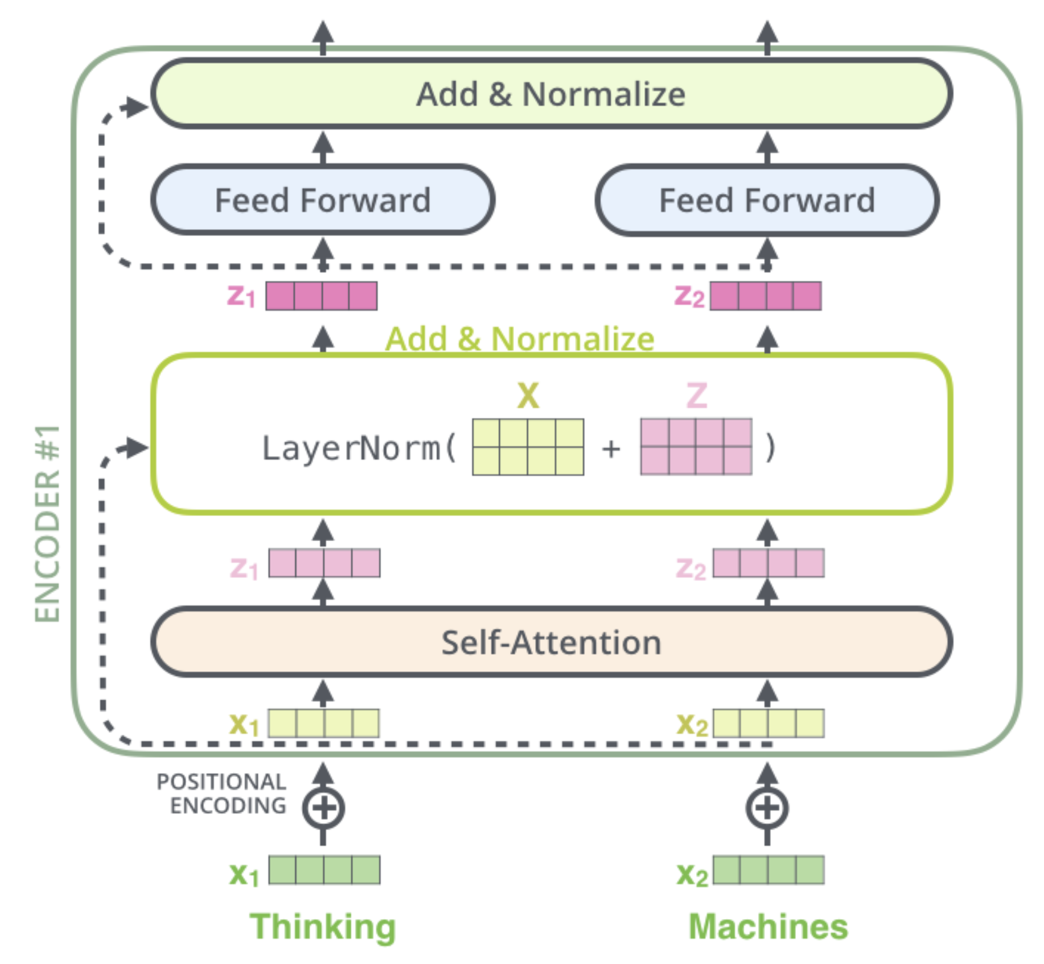
The Full Encoder Block
Encoder block consisting of:
Multi-headed self-attention
Feedforward NN (FC 2 layers)
Skip connections
Layer normalization - Similar to batch normalization but computed over features (words/tokens) for a single sample
[Alammar, 2018]
Notes:
FCNN 512 2048 dim

Slide 28
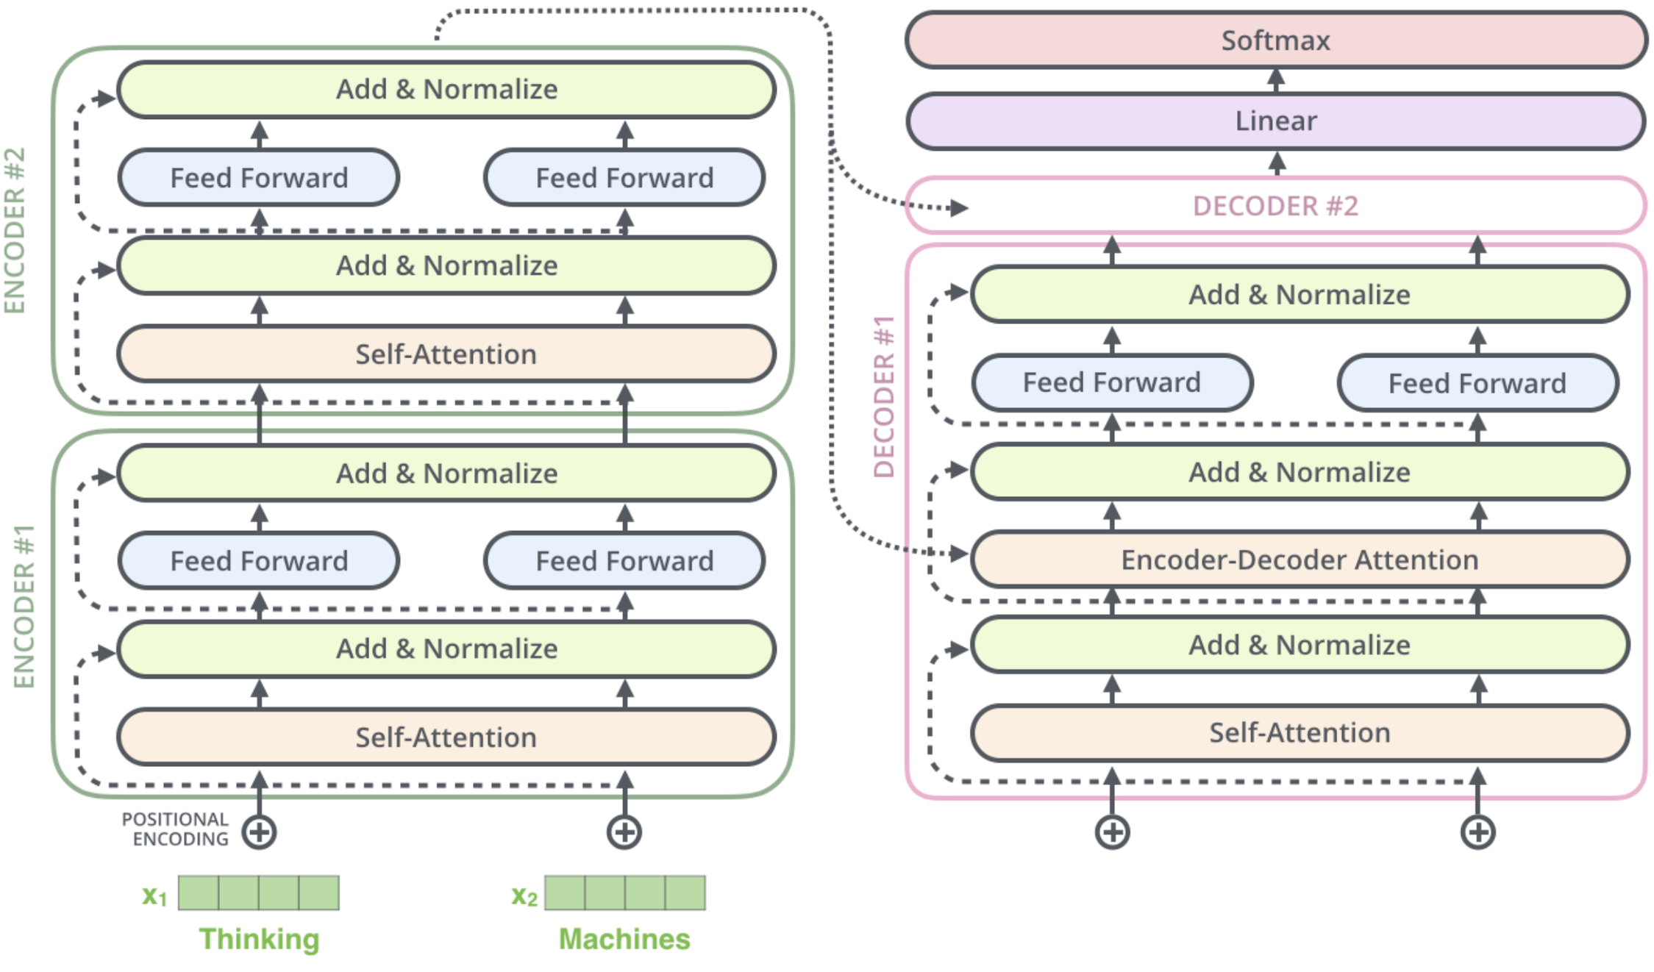
Encoder-Decoder Architecture - Small Example
[Alammar, 2018]
Notes:
Stack the encoder and decoder blocks. Depth instead of recurrence. Allows better parallelization.
Decoder side: cross-attentions (KV from encoder output). Impose causality constraints by left-to-right masking.
Works great. Think about it as attention looking at different thing in the input. Earlier layer, shallow structure (locality), then semantics, ...

Slide 29
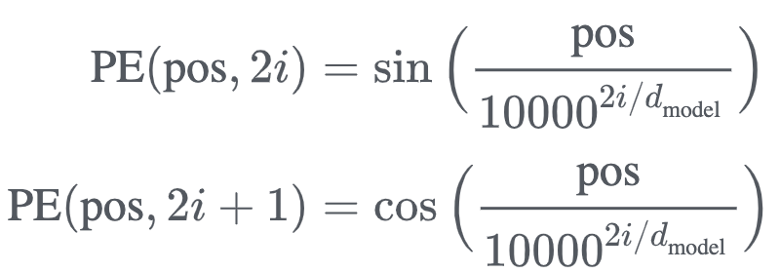
Positional Encodings
Attention mechanism has no locality bias - no notion of word order
Add positional encodings to input embeddings to let model learn relative positioning
[Alammar, 2018]
Notes:
Exact PE not very important, but need some positional signal that the model can use to learn relative positioning

Slide 30
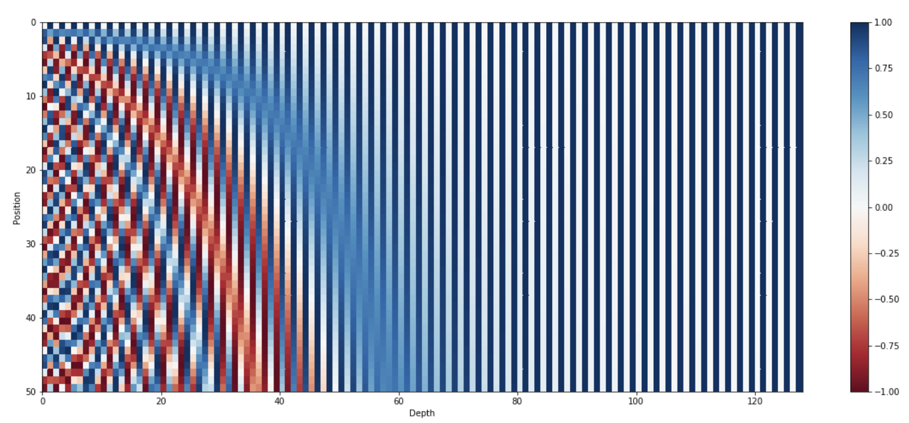
Positional Encodings
[Kazemnejad, 2019]
Notes:
https://kazemnejad.com/blog/transformer_architecture_positional_encoding/

Slide 31
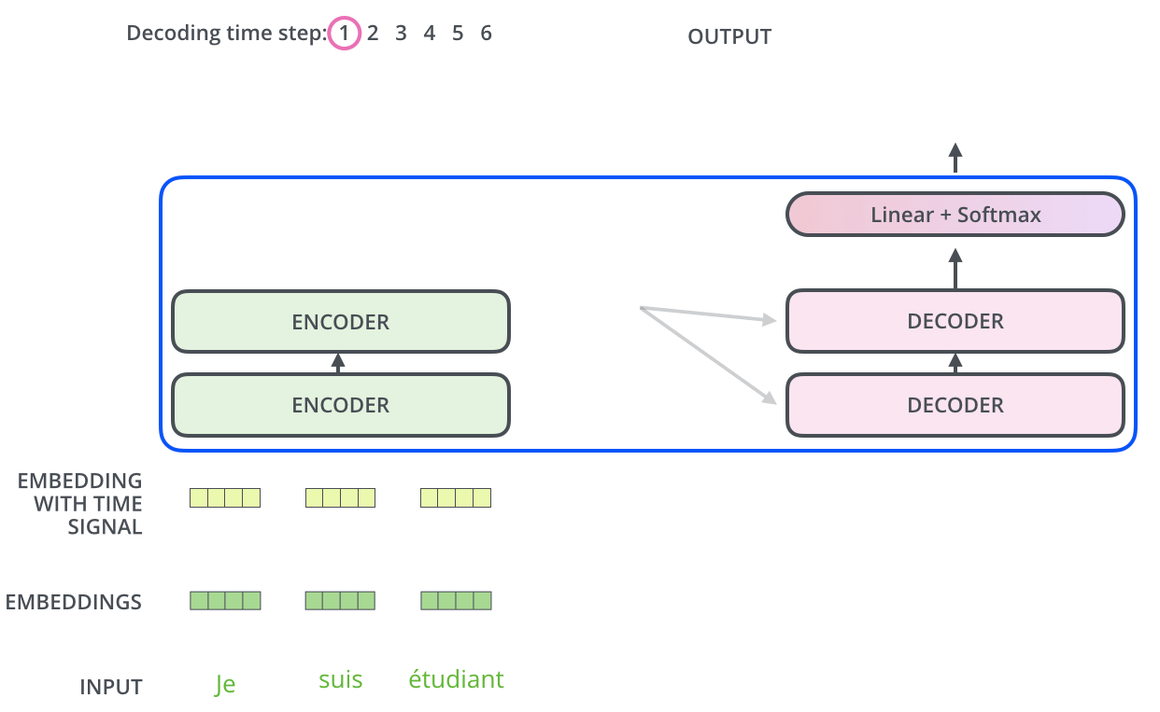
Let’s start the encoding!
[Alammar, 2018]

Slide 32
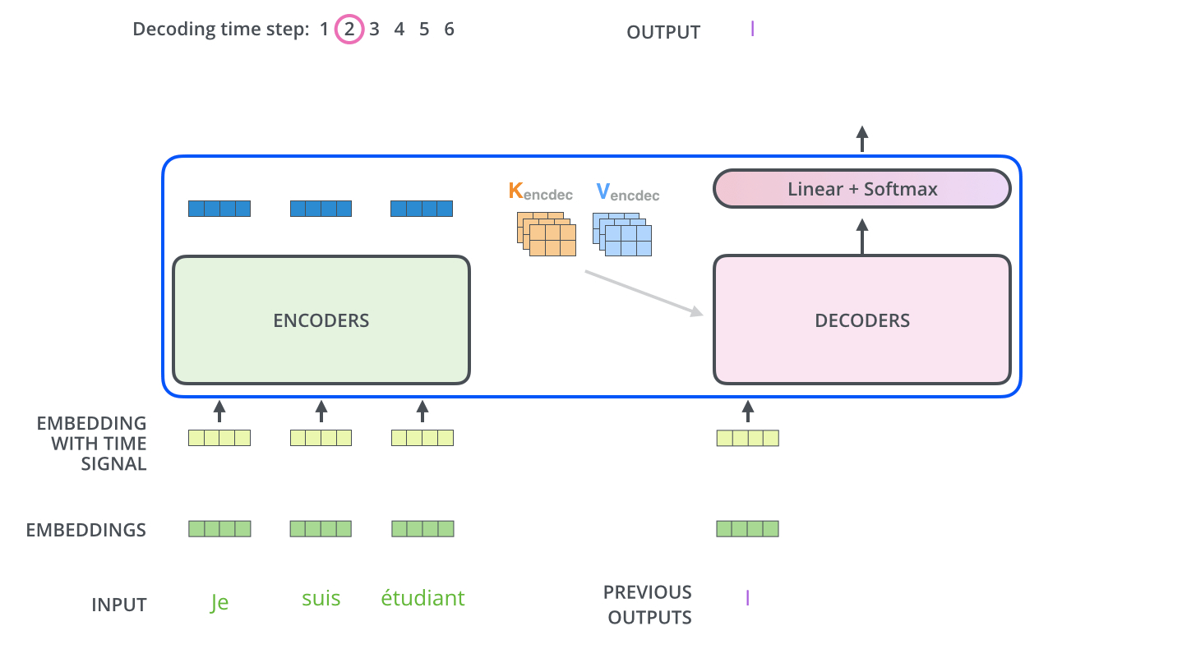
Decoding procedure
[Alammar, 2018]

Slide 33
Producing the output text
The output from the decoder is passed through a final fully connected linear layer with a softmax activation function
Produces a probability distribution over the pre-defined vocabulary of output words (tokens)
Greedy decoding picks the word with the highest probability at each time step
[Alammar, 2018]

Slide 34
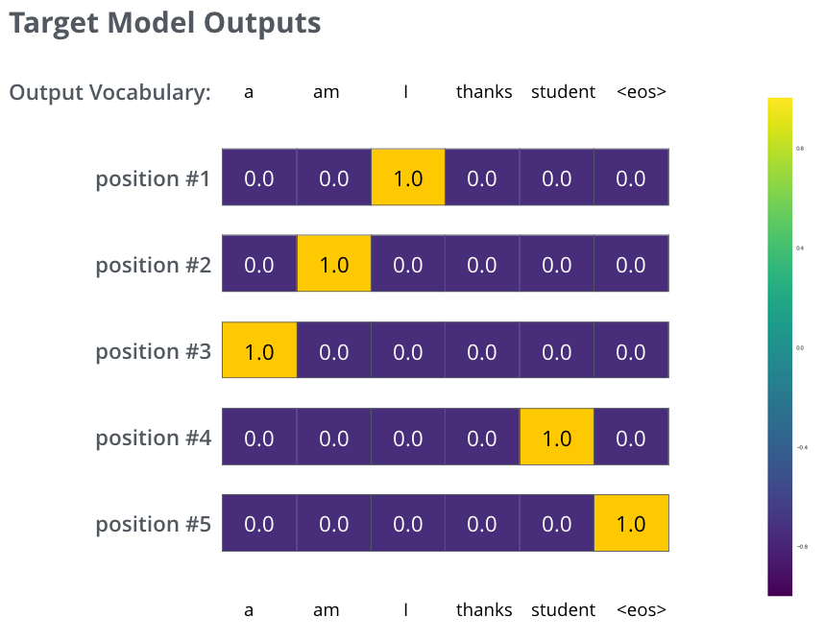
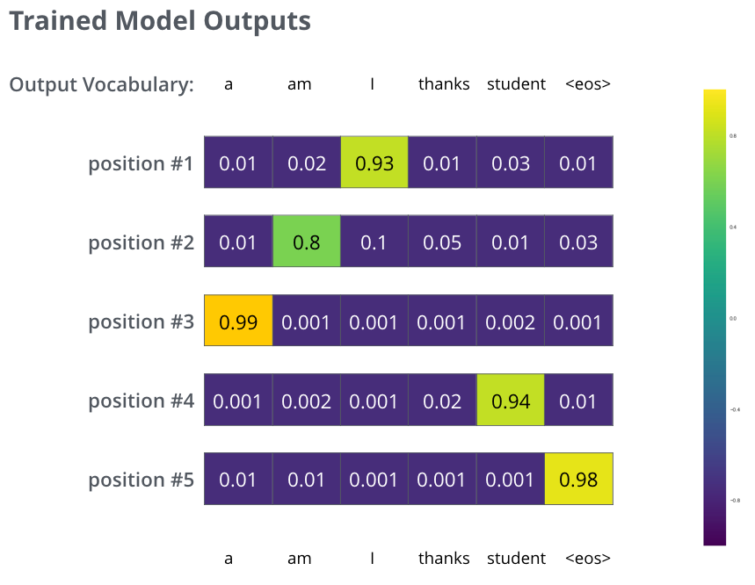
Training Objective
[Alammar, 2018]
Notes:
Sum up cross entropy loss for each output token
Teacher-forcing

Slide 35
Complexity Comparison
[Vaswani et al., 2017]
Notes:
n is the sequence length, d is the representation dimension, k is the kernel size of convolutions
The key is the last column.
Attention is cheap if n is small. Common for many NLP problems.
However, scales quadratically in sequence length. Can be a problem for longer sequences.
Longer sequence lengths: Other approaches, sparse/restriced attention, approximate attention, sliding windows etc...

Slide 36
04
BERT

Slide 37
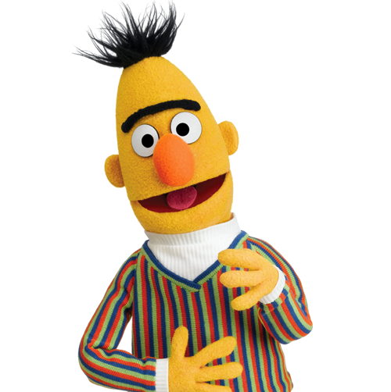
BERT
Bidirectional Encoder Representations from Transformers
Self-supervised pre-training of Transformers encoder for language understanding
Fine-tuning for specific downstream task
Notes:
How NLP cracked the transfer learning… (compare with transfer learning for computer vision)

Slide 38
BERT Training Procedure
[Devlin et al., 2018]
Notes:
Remove the very top that produce the mask prediction, and instead add a model head for the specific task.

Slide 39
BERT Training Objectives
Masked Language Modelling
Next Sentence Prediction
[Devlin et al., 2018]
Notes:
MLM illustration. “Fill in the blanks” 15% of the words maksed out. Trade off between masking too little (too expensive to train) and too much (not enough context).

Slide 40
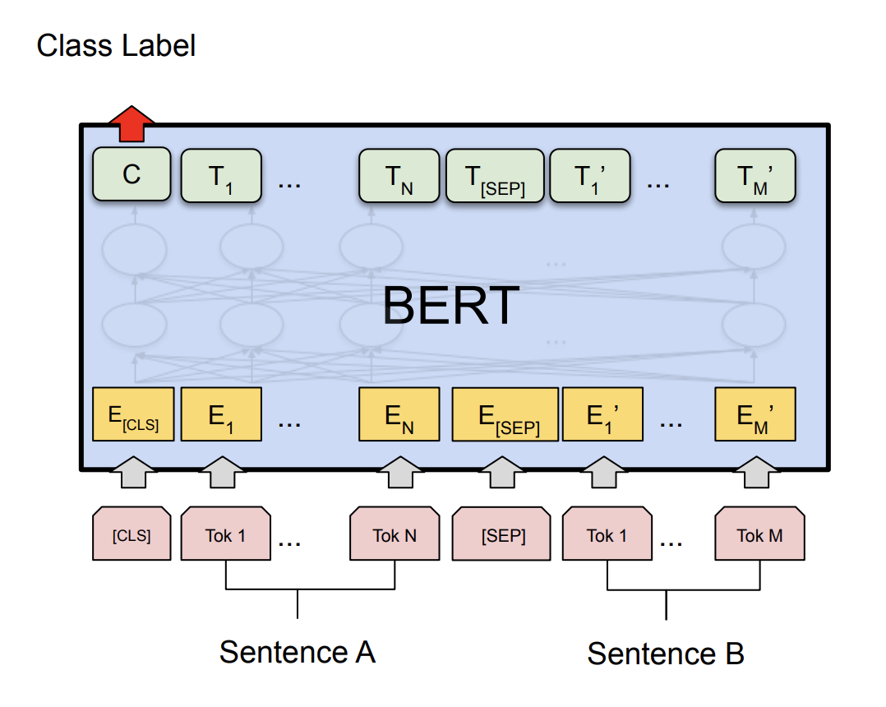
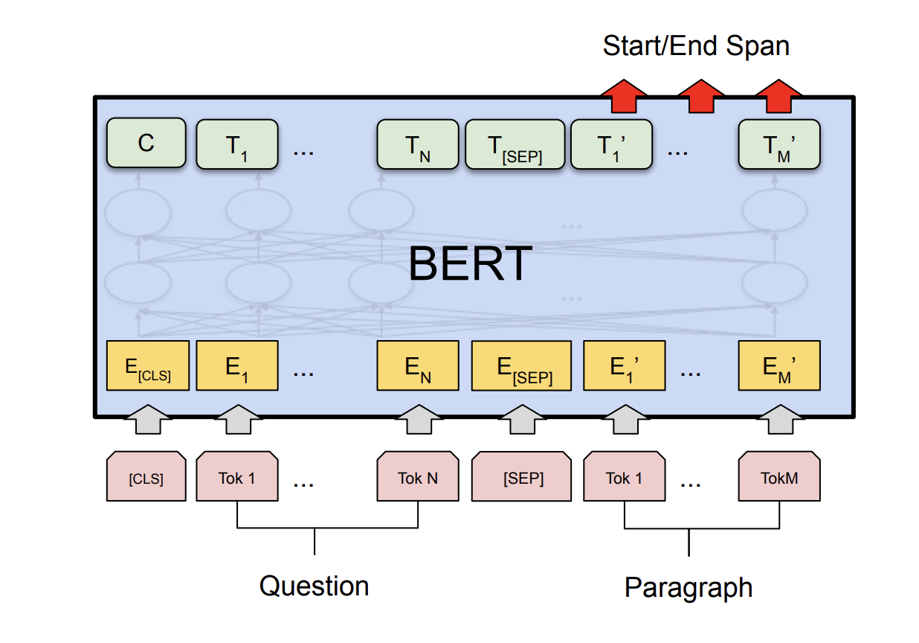
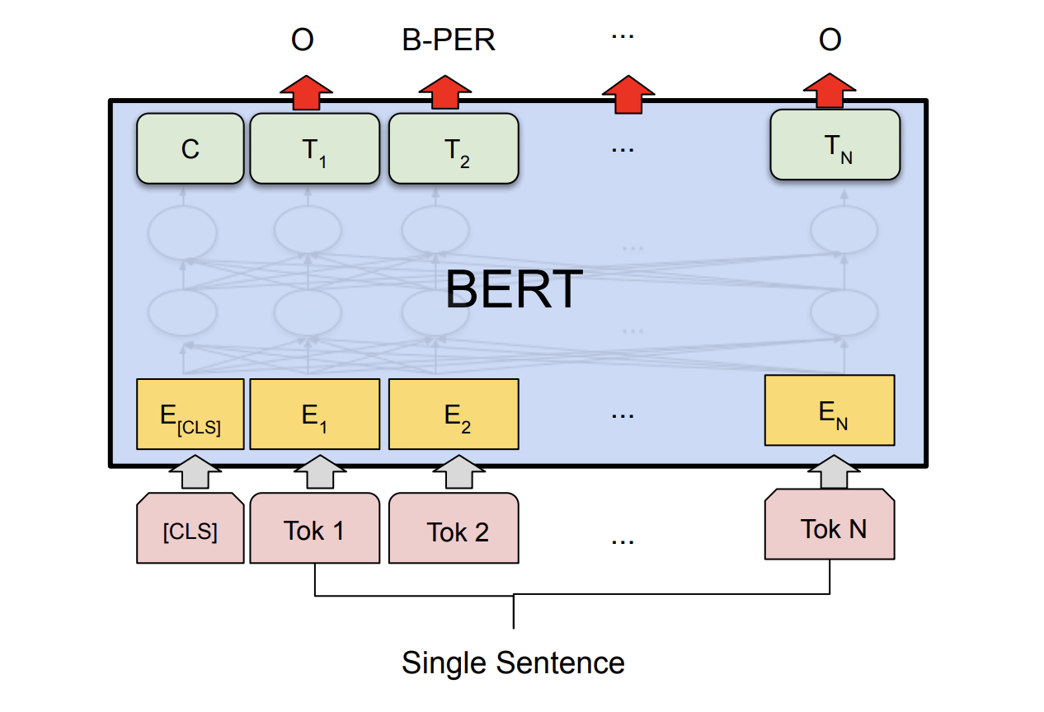
BERT Fine-Tuning Examples
Sentence Classification
Question Answering
Named Entity Recognition
[Devlin et al., 2018]
Notes:
Since BERT came around in late 2018, there has been a massive number of new models and midifications. Overall structure with layers of attention the same, different hyper param settings, training objectives etc

Slide 41
Exploring the Limits of Transfer Learning (T5)
Scaling up models size and amount of training data helps a lot
Best model is 11B (!!) parameters
Exact pre-training objective (MLM, NSP, corruption) doesn’t matter too much
SuperGLUE benchmark:
[Raffel et al., 2019]
Notes:
Paper contains a thorough “ablation” study of for text-to-text setup… Training objective, attention masking, MLM masking rate, ...

Slide 42
05
Practical Examples

Slide 43
BERT in low-latency production settings
[Devlin, 2020]

Slide 44
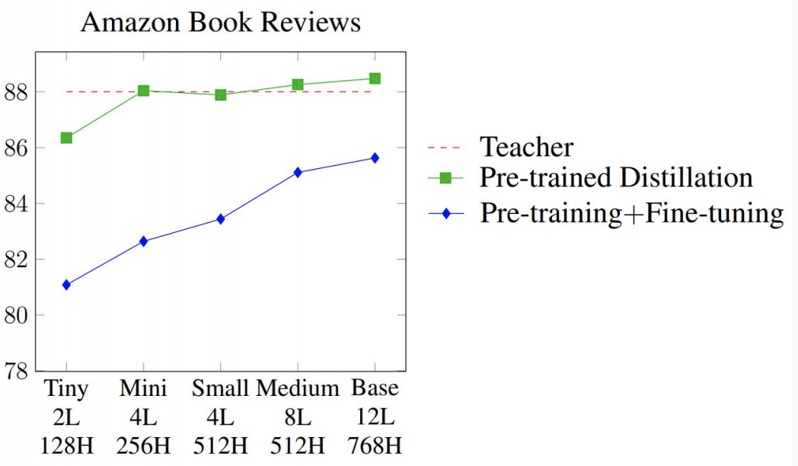
Distillation
Modern pre-trained language models are huge and very computationally expensive
How are these companies applying them to low-latency applications?
Distillation!
Train SOTA teacher model (pre-training + fine-tuning)
Train smaller student model that mimics the teacher’s output on a large dataset on unlabeled data
Why does it work so well?
[Turc, 2020]
[Devlin, 2020]

Slide 45
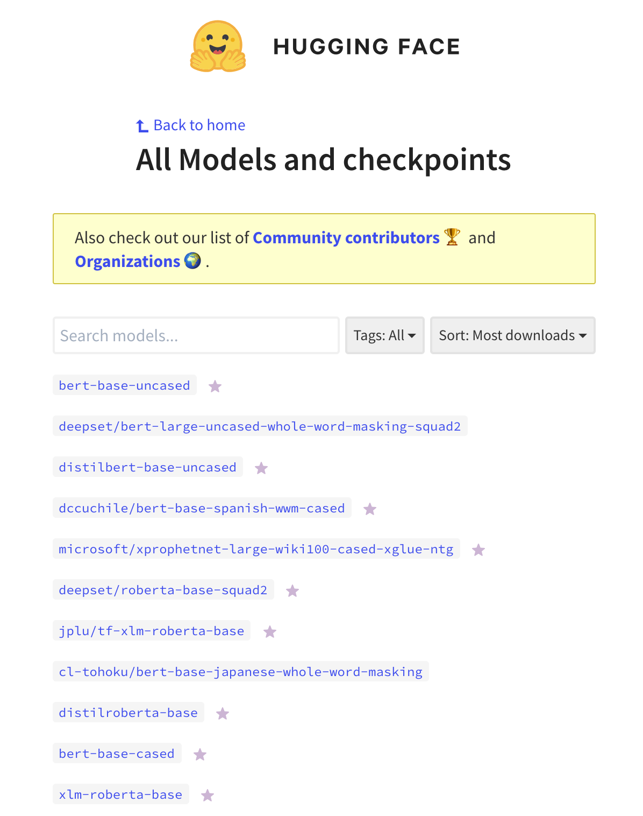
Transformers in TensorFlow using HuggingFace 🤗
The HuggingFace Library contains a majority of the recent pre-trained State-of-the-art NLP models, as well as over 4 000 community uploaded models
Works with both TensorFlow and PyTorch

Slide 46
Transformers in TensorFlow using HuggingFace 🤗
from transformers import BertTokenizerFast, TFBertForSequenceClassification
from datasets import load_dataset
import tensorflow as tf
dataset = load_dataset("imdb").shuffle()
tokenizer = BertTokenizerFast.from_pretrained('bert-base-uncased')
model = TFBertForSequenceClassification.from_pretrained('bert-base-uncased', num_labels=2)
train_encodings = tokenizer(dataset['train']['text'], truncation=True, padding=True)
train_dataset = tf.data.Dataset.from_tensor_slices((dict(train_encodings), dataset['train']['label']))
val_dataset = ... // Analogously
optimizer = tf.keras.optimizers.Adam(learning_rate=5e-5)
model.compile(optimizer=optimizer, loss=model.compute_loss)
model.fit(train_dataset.batch(16), epochs=3, batch_size=16)
model.evaluate(val_dataset.batch(16), verbose=0)
Notes:
IMDB dataset - sentiment classification of sentences from movie reviews.

Slide 47
Transformers in TensorFlow using HuggingFace 🤗
from transformers import BertTokenizerFast, TFBertForSequenceClassification
from datasets import load_dataset
import tensorflow as tf
dataset = load_dataset("imdb").shuffle()
tokenizer = BertTokenizerFast.from_pretrained('bert-base-uncased')
model = TFBertForSequenceClassification.from_pretrained('bert-base-uncased', num_labels=2)
train_encodings = tokenizer(dataset['train']['text'], truncation=True, padding=True)
train_dataset = tf.data.Dataset.from_tensor_slices((dict(train_encodings), dataset['train']['label']))
val_dataset = ... // Analogously
optimizer = tf.keras.optimizers.Adam(learning_rate=5e-5)
model.compile(optimizer=optimizer, loss=model.compute_loss)
model.fit(train_dataset.batch(16), epochs=3, batch_size=16)
model.evaluate(val_dataset.batch(16), verbose=0)

Slide 48
Transformers in TensorFlow using HuggingFace 🤗
from transformers import BertTokenizerFast, TFBertForSequenceClassification
from datasets import load_dataset
import tensorflow as tf
dataset = load_dataset("imdb").shuffle()
tokenizer = BertTokenizerFast.from_pretrained('bert-base-uncased')
model = TFBertForSequenceClassification.from_pretrained('bert-base-uncased', num_labels=2)
train_encodings = tokenizer(dataset['train']['text'], truncation=True, padding=True)
train_dataset = tf.data.Dataset.from_tensor_slices((dict(train_encodings), dataset['train']['label']))
val_dataset = ... // Analogously
optimizer = tf.keras.optimizers.Adam(learning_rate=5e-5)
model.compile(optimizer=optimizer, loss=model.compute_loss)
model.fit(train_dataset.batch(16), epochs=3, batch_size=16)
model.evaluate(val_dataset.batch(16), verbose=0)

Slide 49
Transformers in TensorFlow using HuggingFace 🤗
from transformers import BertTokenizerFast, TFBertForSequenceClassification
from datasets import load_dataset
import tensorflow as tf
dataset = load_dataset("imdb").shuffle()
tokenizer = BertTokenizerFast.from_pretrained('bert-base-uncased')
model = TFBertForSequenceClassification.from_pretrained('bert-base-uncased', num_labels=2)
train_encodings = tokenizer(dataset['train']['text'], truncation=True, padding=True)
train_dataset = tf.data.Dataset.from_tensor_slices((dict(train_encodings), dataset['train']['label']))
val_dataset = ... // Analogously
optimizer = tf.keras.optimizers.Adam(learning_rate=5e-5)
model.compile(optimizer=optimizer, loss=model.compute_loss)
model.fit(train_dataset.batch(16), epochs=3, batch_size=16)
model.evaluate(val_dataset.batch(16), verbose=0)

Slide 50
06
Wrap Up

Slide 51
Summary
Transformers have blown other architectures out of the water for NLP
Get rid of recurrence and rely on self-attention
NLP pre-training using Masked Language Modelling
Most recent improvements using larger models and more data
Distillation can make model serving and inference more tractable

Slide 52
Thanks
/November 25, 2020
Questions?
Karl Fredrik Erliksson PhD Candidate, KTH and Peltarion kferl@kth.se

